Slide 1



Ethics in IT
Class VIII
lab 2

Slide 2

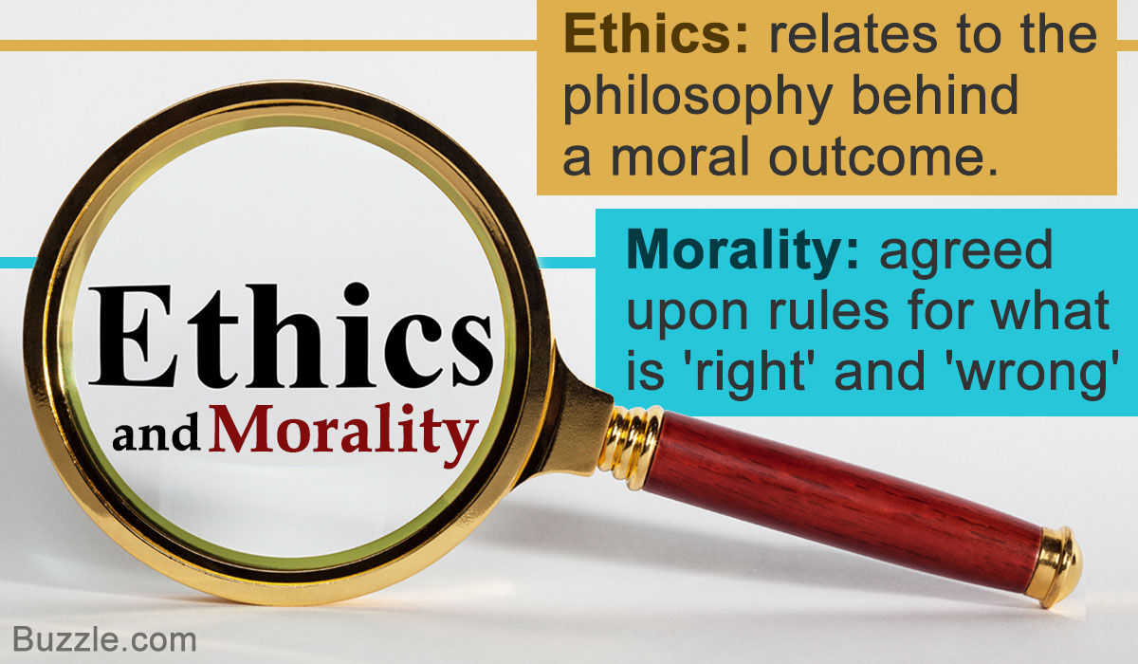
Ethics vs Morality

Slide 3
Basic Principle of Ethics
Do no harm
Make things better
Respect others
Be fair
Be loving

Slide 4
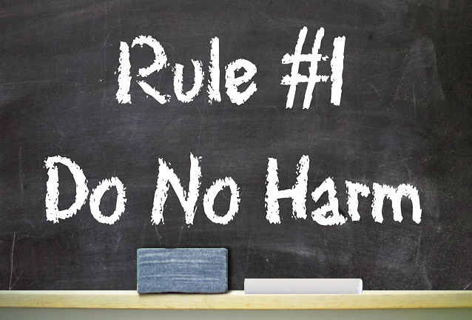
Do No Harm
try not to
harm people

Slide 5

Make Things Better
Make people
feel good
about
themselves.

Slide 6
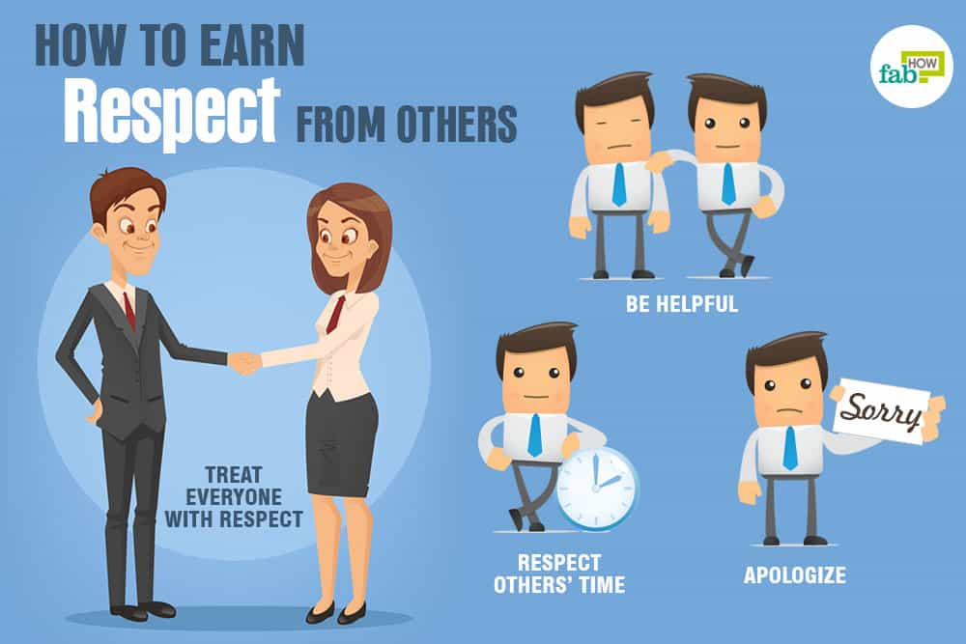
Respect Others
respecting
others
will make you
a special one

Slide 7
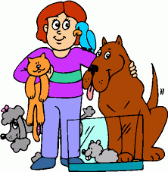
Be Loving
Show people and
animal that
you care about
them

Slide 8



